Slide 1
Charan N Data Visualizations Using Excel Titanic Dataset

Slide 2
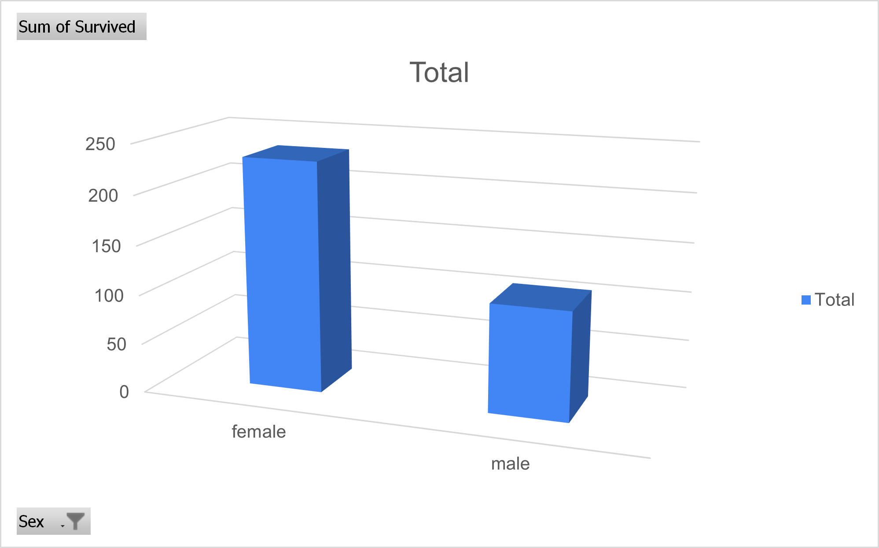
COMPARISON OF SURVIVAL BETWEEN MALE AND FEMALE
female | 233
male | 109
Grand Total | 342
There were total of 109 male and 233 female passengers survived in the titanic sink. Which shows that more female passengers survived than male passengers.

Slide 3
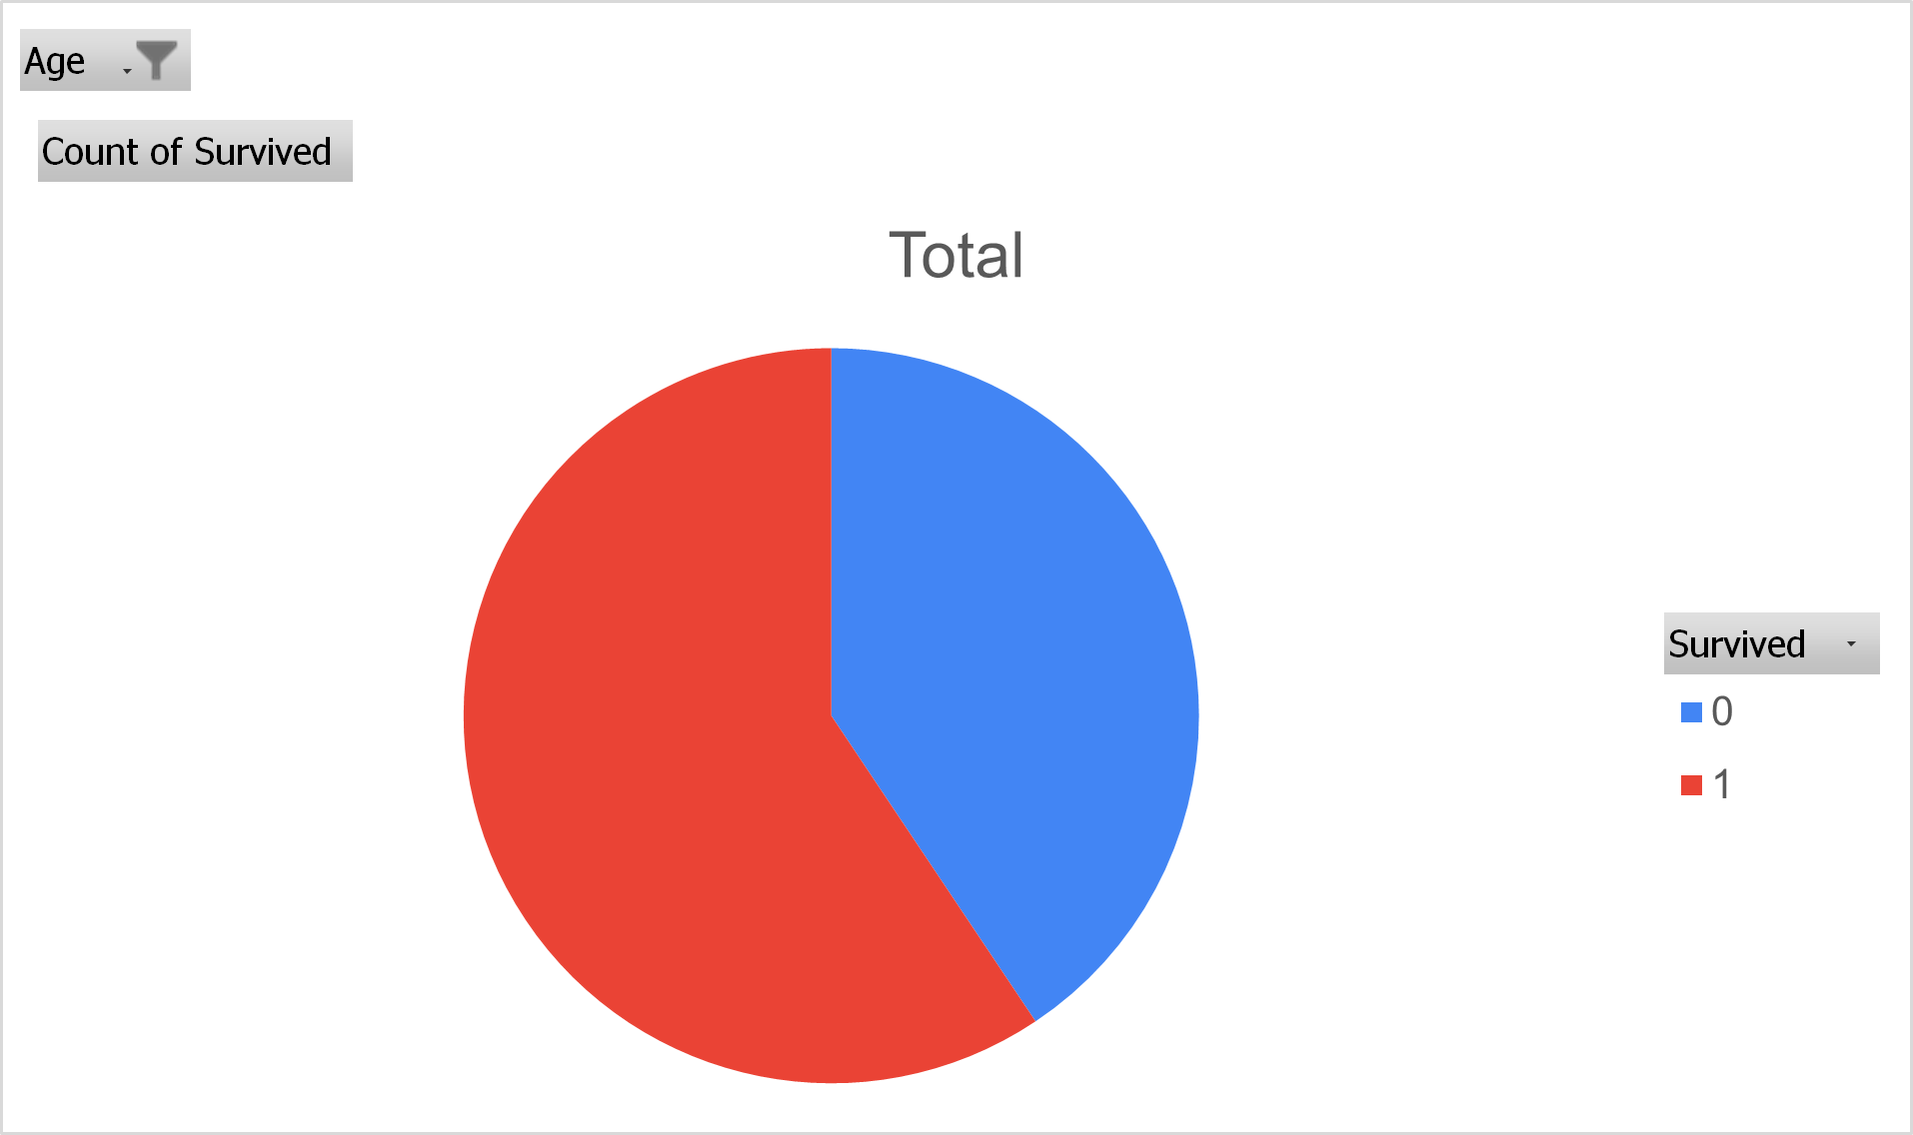
SURVIVAL OF CHILDREN IN THE SHIP
0 | 26
1 | 38
Grand Total | 64
There were 64 children travelled in the ship. Out of 64, 38 children survived and 26 didn’t survived. This shows that more children have been survived.

Slide 4
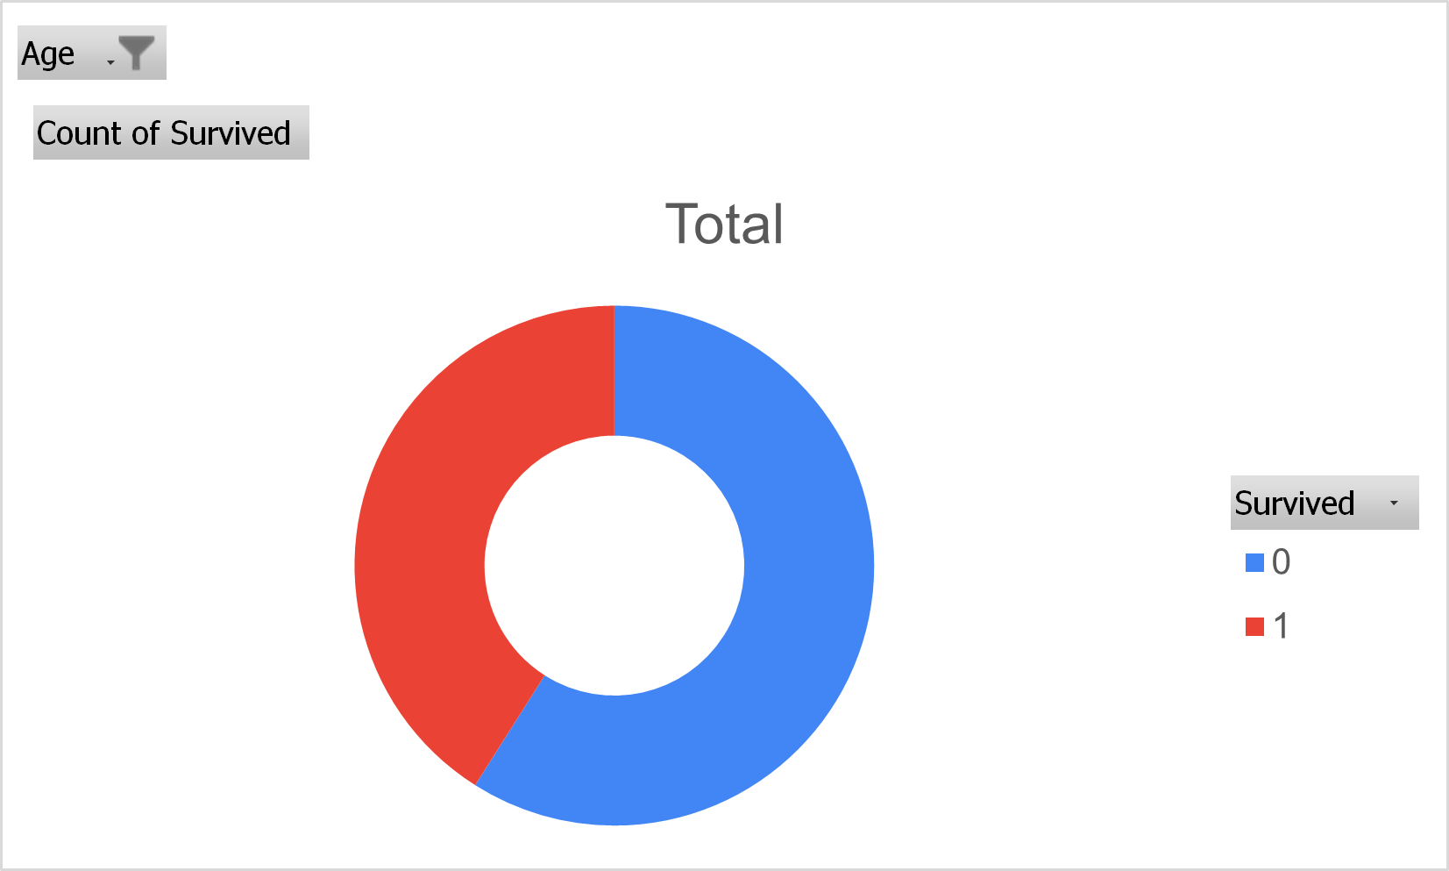
SURVIVAL OF TEENAGERS IN THE SHIP
0 | 59
1 | 41
Grand Total | 100
Coming to teenagers, total number of teenagers in the ship is 100. Survived teenagers are 41 and rest 59 didn’t survived.

Slide 5
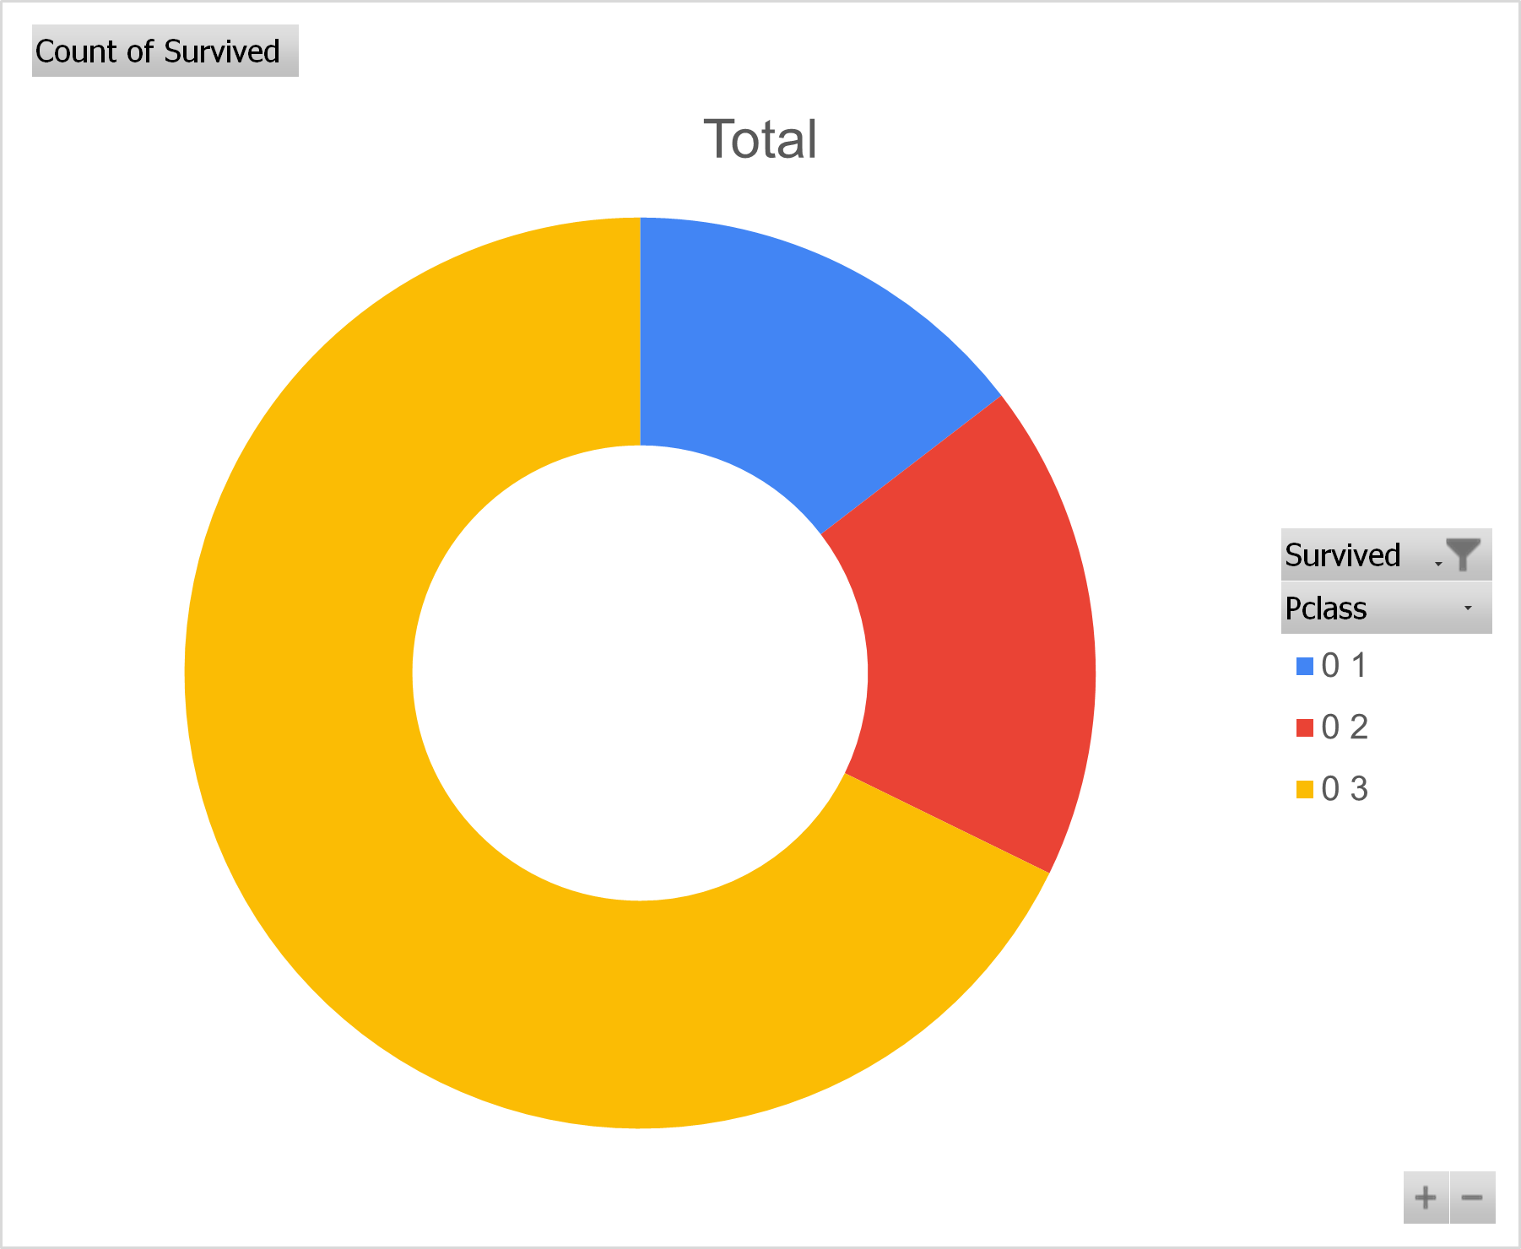
LOCATION OF A PASSENGER ON THE SHIP AFFECT THEIR CHANCES OF SURVIVAL
NOT SURVIVED
1 | 80
2 | 97
3 | 372
Grand Total | 549
Out of which survival chances were different in all the classes. In detail, 136 people survived in class 1, 97 in class 2, 372 in class 3.

Slide 6
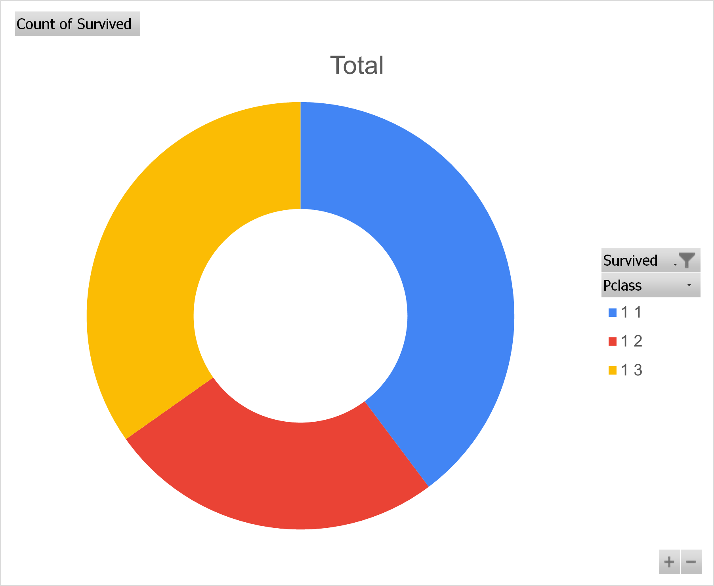
LOCATION OF A PASSENGER ON THE SHIP AFFECT THEIR CHANCES OF SURVIVAL
SURVIVED
1 | 136
2 | 87
3 | 119
Grand Total | 342
Out of which survival chances were different in all the classes. In detail, 136 people survived in class 1, 87 in class 2, 119 in class 3.

Slide 7
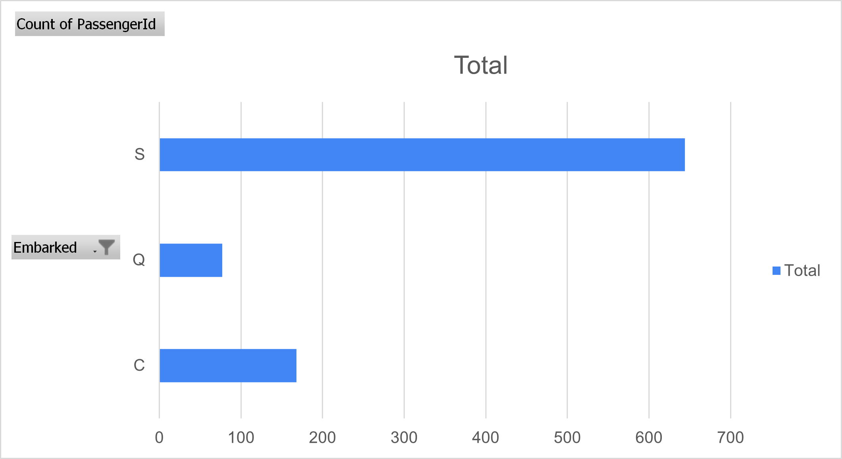
ONE MORE INSIGHT FROM STUDENTS SIDE
COMPARISON OF TRAVELLERS FROM ONBOARDING PLACE
C | 168
Q | 77
S | 644
Grand Total | 889
Other than the above insights, I have taken the people survived from where they have boarded the ship.
There are 3 locations given in the dataset. They are Southampton, Cherbourg, and Queenstown.
Survival count from Cherbourg is 93 out of 644, Queenstown is 30 out of 77, Southampton is 217 out of 644.
I have taken the data using pivot table for total people and another insight for the people survived and compared both.

